Slide 1

Session 4
Selenium WebDriver - Working with Elements

Slide 2
Knowledge Check
Session 3
Different Basic strategies to work with elements in WebDriver?
General steps to launch a browser in WebDriver!
Brief Eclipse Debugging!
findElement() vs findElements()

Slide 3
Topics
Covered
Automating textboxes, text areas, and buttons
Getting an element's text
Getting an element's attribute and CSS values
Automating dropdowns
Automating radio buttons and radio groups
Automating checkboxes

Slide 4
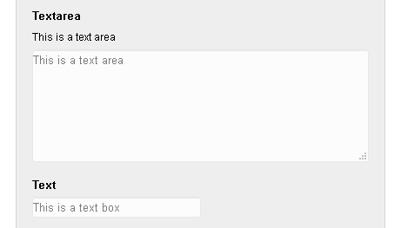

Automating textboxes,
text areas, and buttons
Here we will explore the clear(), sendKeys(), submit() and click() methods of the WebElement interface.

Slide 5
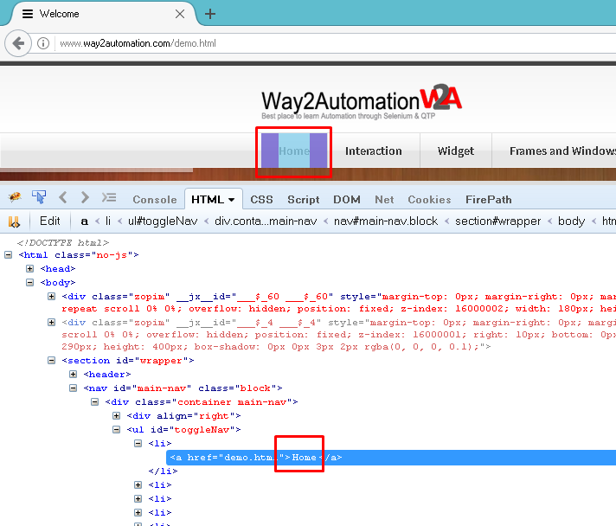
Getting an
element's text
We will retrieve text from an element using the getText() method of the WebElement.
The getText() of the WebElement returns the visible innerText of the element, including sub-elements, without any leading or trailing whitespace.

Slide 6
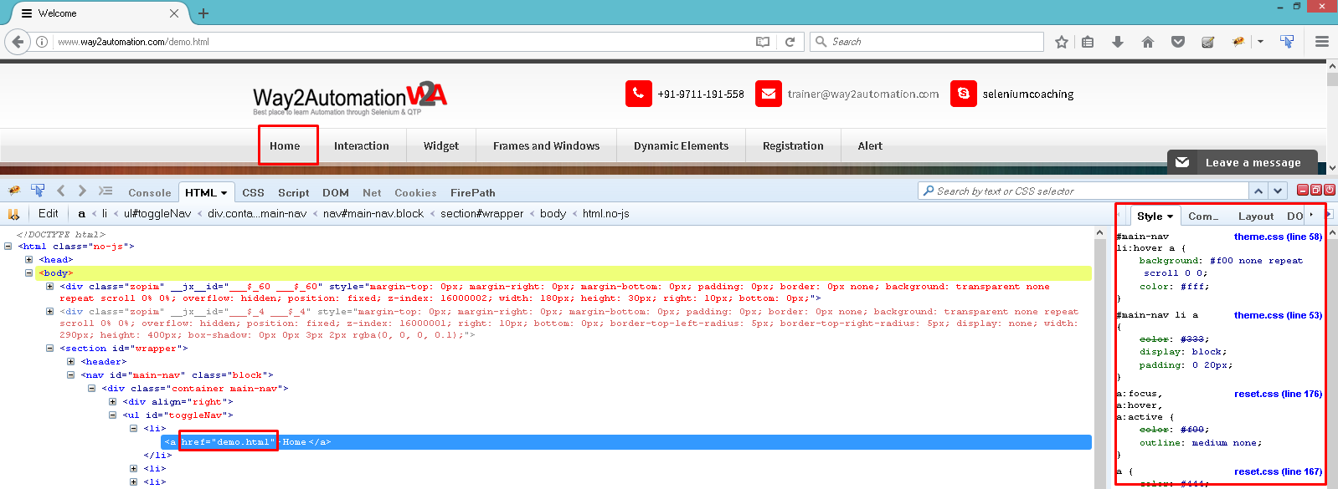
Getting an element's
Attribute and CSS values
We can retrieve and check an element's attribute using the getAttribute() method of the WebElement interface.
We will use the getCSSValue() function to check the style attribute defined for an element.

Slide 7
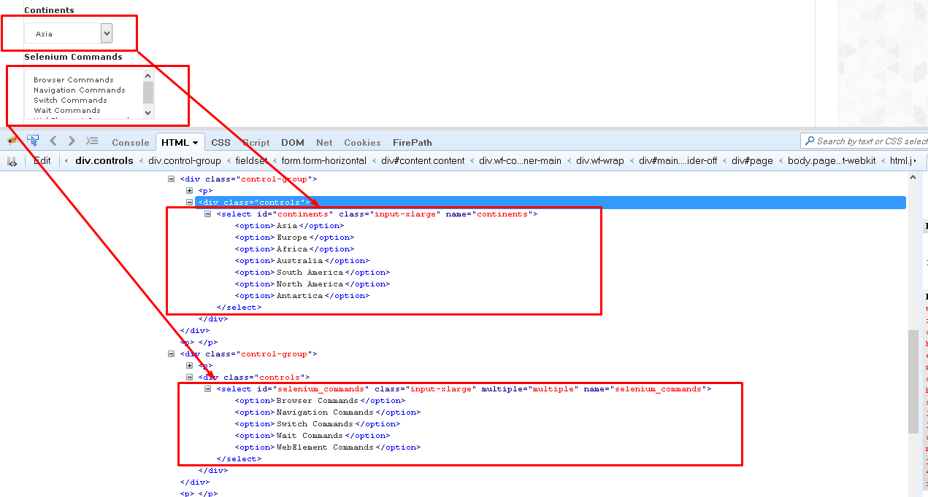
Automating
dropdowns
The Select class provides various methods and properties to interact with dropdowns created with the HTML <select> element.
The Select class provides three different ways to select and deselect the options from dropdowns:
  Selection/deselection by visible text
  Selection/deselection by value
  Selection/deselection by index

Slide 8

Automating radio buttons
and radio groups
Select and Deselect - click() of the WebElement
Selected or Deselected - isSelected().

Slide 9
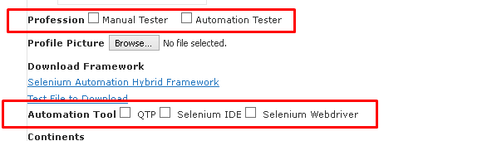
Automating
checkboxes
Select or Deselect - click()
Selected or Deselected - isSelected()

Slide 10


Slide 11
Knowledge Check
Different methods to work with Text Box/Text Area?
How to get the text of an Element?
How to get the Styling information of an element?
Different ways to select values from Drop Down?
What is Radio Group and how to select Radio Button from the same?

Slide 12

Thank you!

